Slide 1
BIG DATA Project Oriah Ben-Guy Mizrahi Mordechai Nosov Ruth Shkop

Slide 2
Table of contents:
Problem Statement
PART A – Creation of Prediction Model
Data Description
Data Engineering
ML Algorithms and Introspection
Model Results
PART B – Making Prediction
PART C – Visualization and Conclusions

Slide 3
Problem Statement
The purpose of this project is to analyse the dataset and build a machine learning pipeline to make a prediction whether the future customers will churn or not, based on demographic, service usage, and payment behaviour data.
The data available is a historical dataset of existing customers with their churn status.
The motivation and possible applications for solving the problem may include risk assessment, targeted marketing campaigns, improving customer retention strategies, and more.

Slide 4
PART A Creation of Prediction Model

Slide 5
1. Data description
The dataset consists 7043 of records examples. In split, 20% of the dataset (1406 records) is used for training the algorithm, and 80% of the dataset (5626 records) is used for testing the algorithm.
The dataset includes 20 features, comprising numerical, categorical, and binary variables.
The target variable is Churn, indicating whether a customer has discontinued services (Yes/No)
The dataset contains missing values in the ‘TotalCharges’ column (11 missing values, that is 0.16% of total Dataset).

Slide 6
1. Data description (continued)
Our team investigated the category features through making a ’for’ loop that brought unique values of each ‘object’ feature. It showed that some of features that seemed like to be Boolean expressions had other unique values ('No phone service’, 'No internet service’). By doing that we found out that some of category features were dependant to others:
‘MultipleLines’ was dependant on ‘PhoneService’
‘OnlineSecurity’, ‘OnlineBackup’, ‘DeviceProtection’, ‘TechSupport’, ‘StreamingTV’ and ‘StreamingMovies’ were dependant on ‘InternetService’

Slide 7
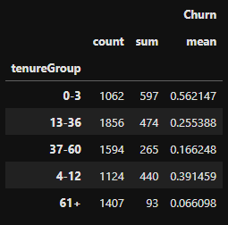
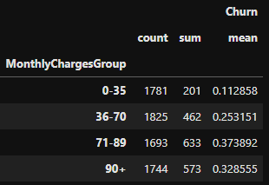
1. Data description (grouping values)
Some of the numerical features were hard to compare due to numerous numerical values in them. Therefore, they were grouped into the feasible categories for better understanding.
Thus, the tenure was grouped into the month periods that showed the most change in customer behavior:
zero-to-3-month
4 month to year
one year to 3 years
4 to 5 years
more than 5 years
The Monthly Charges were respectively grouped by:
0-35
36-70
71-89
90+

Slide 8
1. Data description (feature comparison)
Based on the variable comparison the following assumptions were observed:
There is not much of a difference between the genders
The senior citizens are twice as likely to leave
The customers without a partner/dependents have a bigger chance to leave
The customers who pay monthly, pay by an electronic check or receive their bills not by paper, are more likely to leave
It's more likely for a customer to churn in the first 3 months try and in the first year.
40% of the customer churn after using the Fiber optic internet service
There is a higher chance for a customer to churn if he has an Internet service and has less than 2 additional services to the internet
Customers that pay a monthly charge over then 71 are more likely to churn
Customers that use more services are less likely to churn

Slide 9
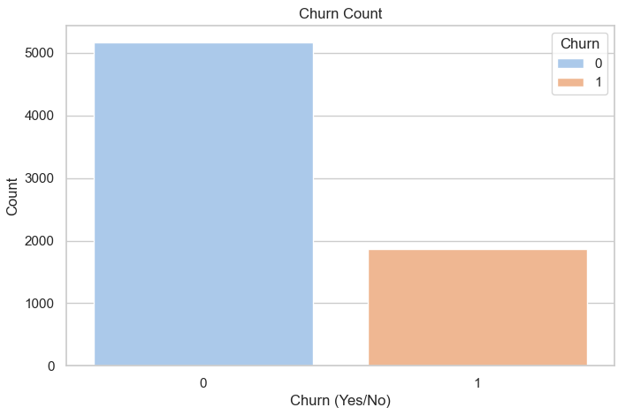
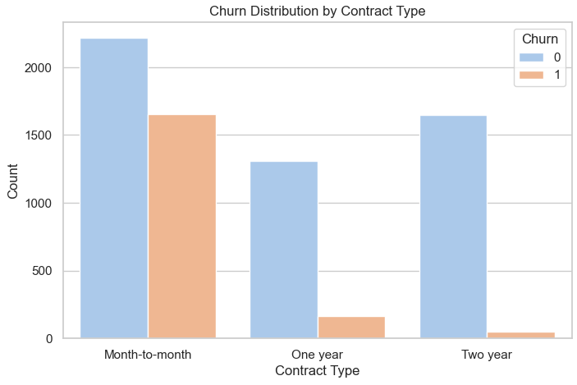
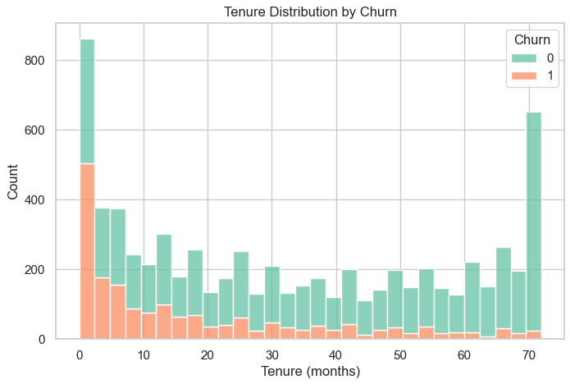
Data visualization and insights
Churn Count
Churn Distribution by Contract Type
Tenure Distribution by Churn
There are more non-churned customers (No) compared to churned customers (Yes), indicating class imbalance.
The churn rate is much higher with month-to-month contract type.
The distribution is right-skewed, with many customers having shorter tenures.

Slide 10
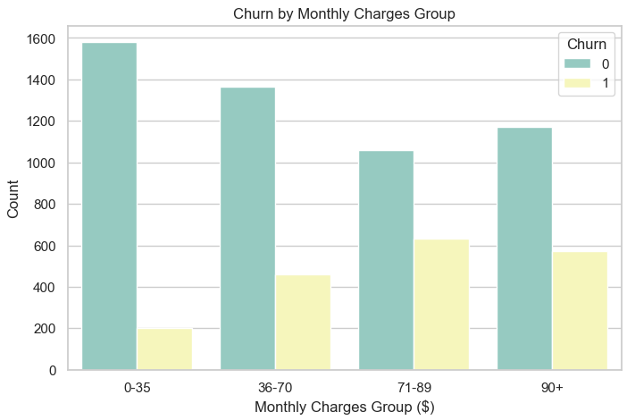
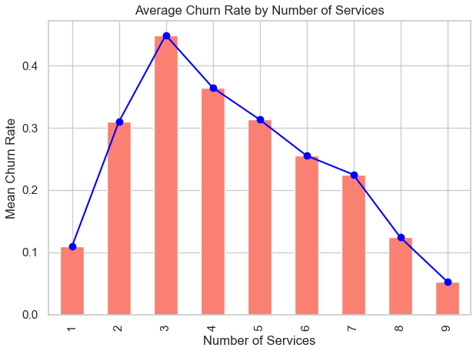
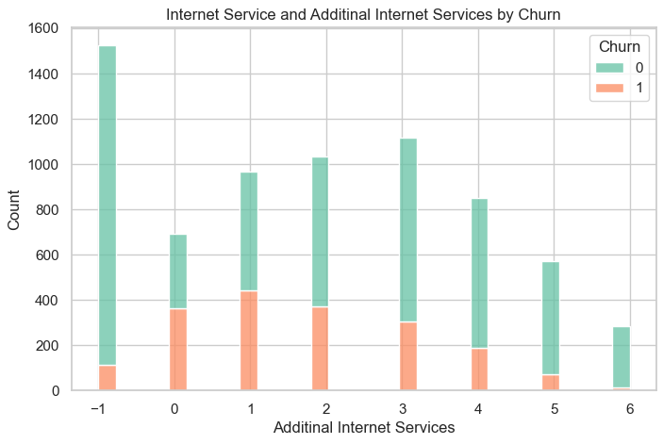
Data visualization and insights
Churn by Monthly Charges Group
Average Churn Rate by Number of Services
Internet Service and Additional Internet Services by Churn
Low price charges lead to lower churn rate and raise of charges bring higher churn rates.
Churn rate peaks out for the customers that have 3 services, and it drops with more services included.
More internet options have higher churn rates than internet only customers.

Slide 11
2. Data engineering
The feature customer_id was removed and was added back after the algorithm was finished.
The feature "num_services" was added: it calculates the number of services that each customer has.
Since the number of missing values is low (0.16%) and does not provide any sufficient change to the dataset, the decision to remove rows with missing values was made.
All the features were transformed into numeric values, and category features were broken into new features (using ‘get_dummies’ method) where each feature represented each unique value of that category feature with Boolean values (1 and 0).
Relationships were inspected by making correlation table and heatmap.

Slide 12
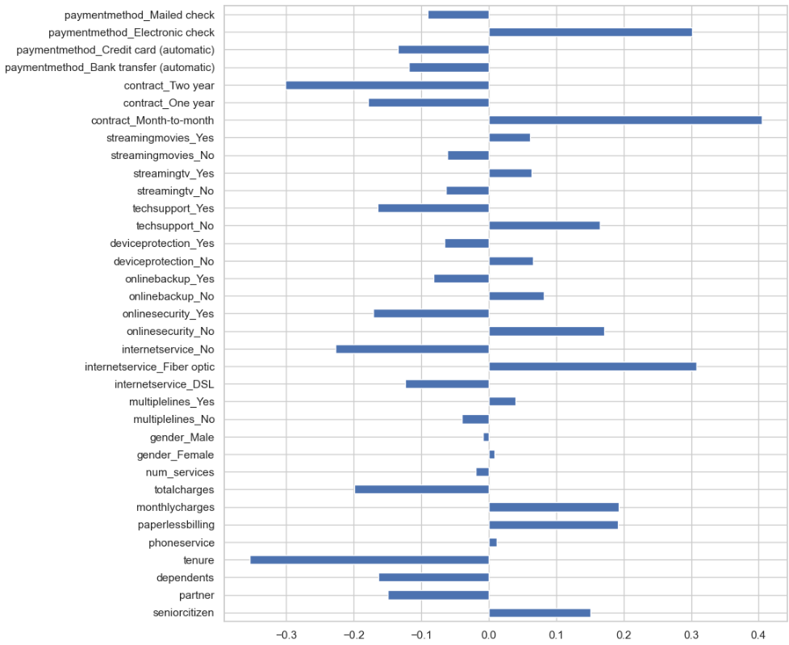
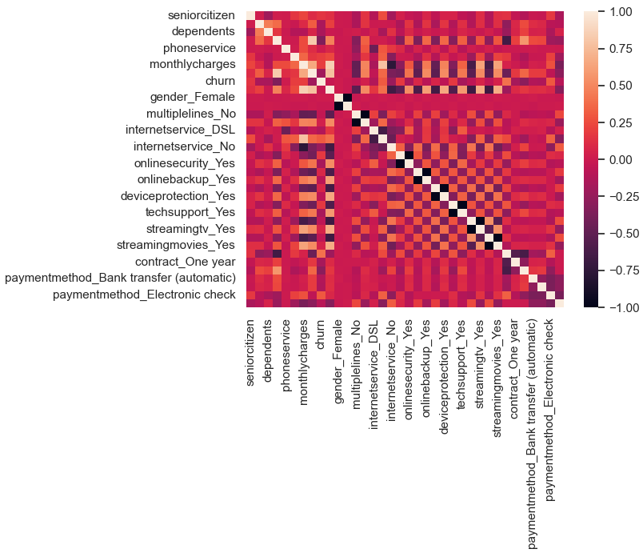
Correlation inspection
The highest correlation was shown by Electronic check payment method, Contract types, Fiber Optic internet service, and Tenure.

Slide 13
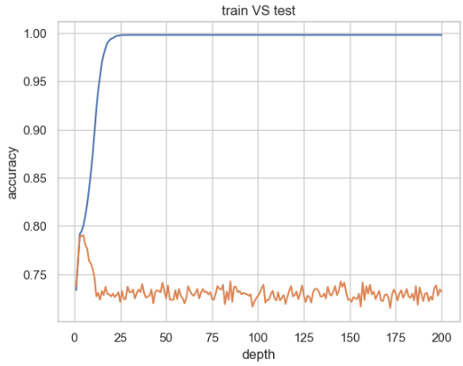
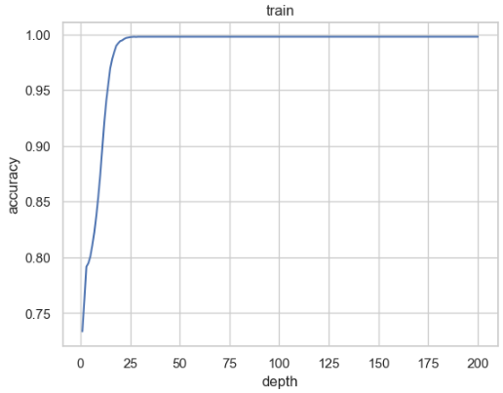
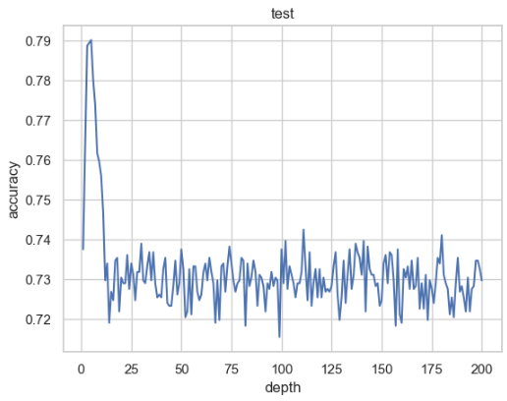
3. ML Algorithms and introspection (Decision tree)
Based on the prepared for ML algorithms dataset the decision tree was learned on train. The more tree depth is given – the higher accuracy, but when testing the algorithm, the accuracy dropped dramatically with higher depth due to overfitting factor. Using the loop to find out the best accuracy, optimal tree depth turned out to be 5.

Slide 14
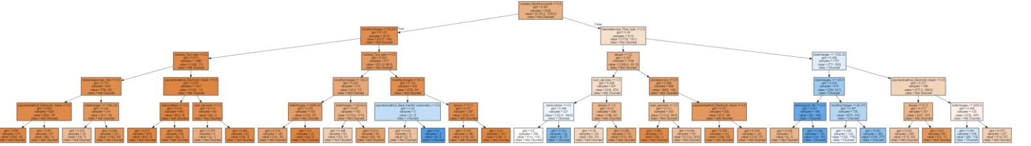
3. ML Algorithms and introspection (Decision tree)

Slide 15
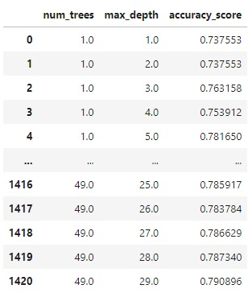

3. ML Algorithms and introspection (random forest)
To check if the accuracy can increase, the random forest algorithm was used.
Different max depth and number of trees combinations were estimated by using a nested loop to identify the best fit combination that achieves highest accuracy on test data.
Optimal number of trees is 12 with depth number of 9 and the accuracy score 81,15%.

Slide 16
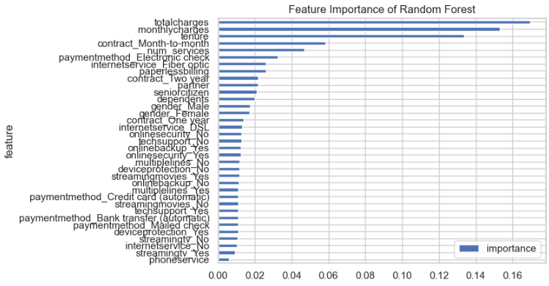
3. ML Algorithms (random forest)
As we can see, the most important features are Total charges, Monthly charges, and Tenure.

Slide 17
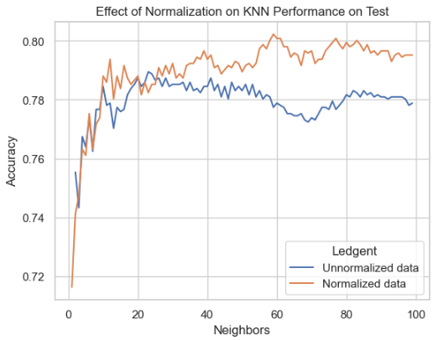
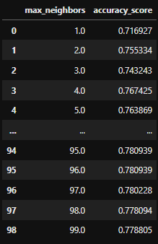
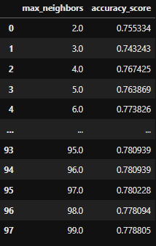


3. ML Algorithms (K Nearest Neighbours)
When Going through K Nearest Neighbours (KNN) prediction model, the different K values were inspected within range of 100.
The highest accuracy of 78,94% was shown with 23 number of neighbours with unnormalized data.
After normalizing data accuracy hopped to 80,22% with 59 neighbours, which is extra 1,28% of accuracy.
Unnormalized Data
Normalized Data

Slide 18
4. Model results
Best accuracy results:
Decision tree:
Test: 79.02%
Train: 99.78%
Random Forest: 81.15%
KNN (Unnormalized data): 78.94%
KNN (Normalized data): 80.22%
Benchmark performance on test: 73.7%
The algorithms we preformed beat the benchmark performance

Slide 19
PART B Making Prediction

Slide 20
Applying the model to make a prediction
To make a prediction whether the customers are likely to churn or not, the dataset of 25 000 customers was provided in a semi structured Data Base. The dataset was converted into the library using MongoDB, and then transformed to a structured Data Frame using the MQL query.
After the dataset was cleaned and prepared for prediction, the model with the best accuracy was used, which is the Random Forest with the score of 81.15%.

Slide 21
PART C Visualization and Conclusions

Slide 22
Data Visualization and explanation
The dataset with prediction was put into the Tableau Prep and then converted into a Star Scheme model, it contained three dimensions tables and one fact table. To understand the predicted data, the model was transferred into the Tableau Desktop for a data visualization and conclusion explanation.

Slide 23
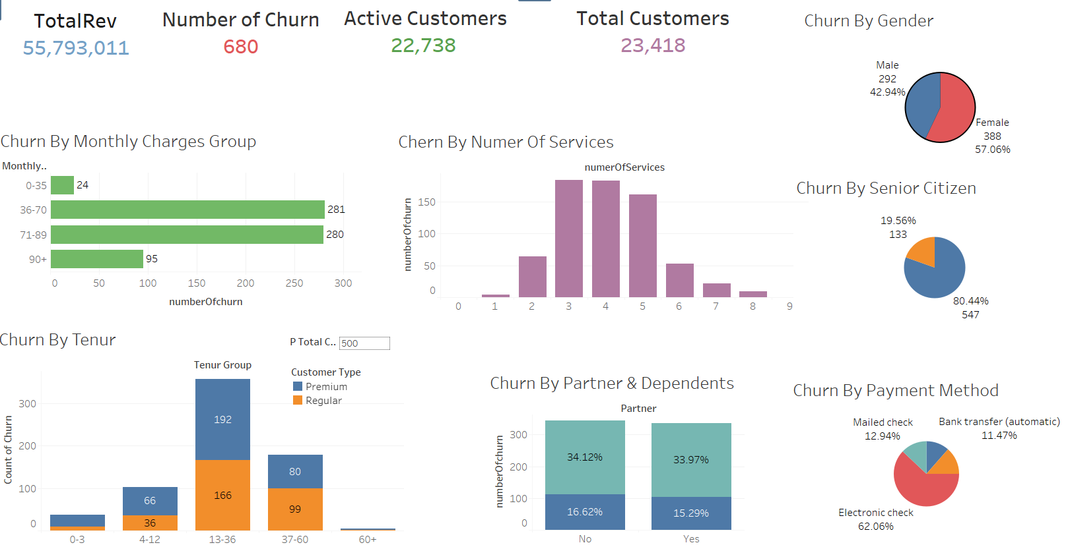
Churn Dashboard
The dashboard provides data needed for the prediction analysis

Slide 24
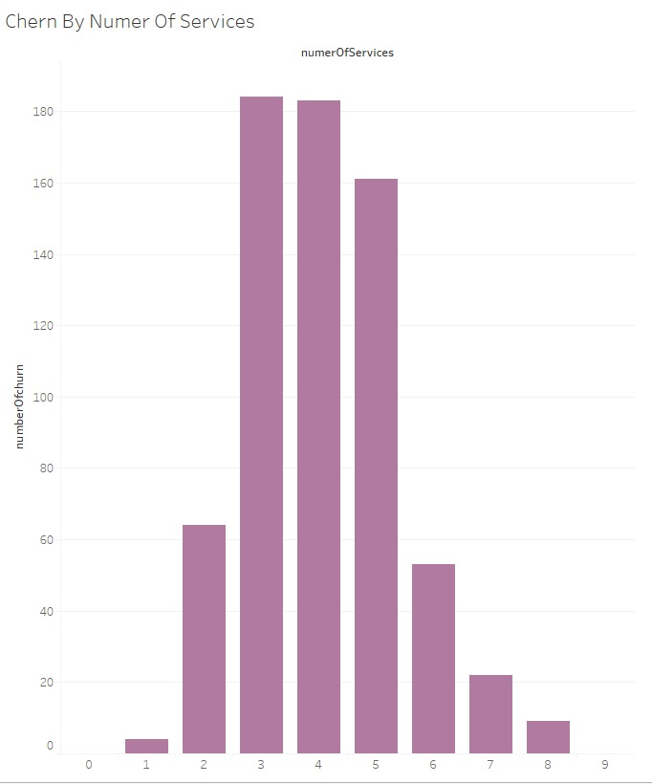
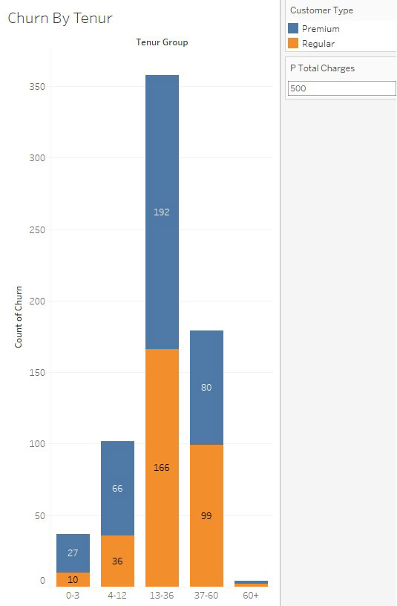
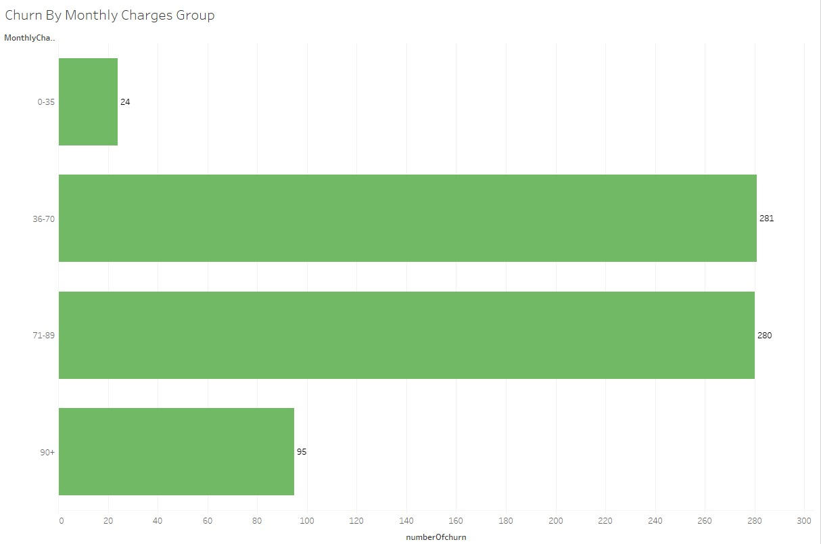
Insights
The highest churn rates are for the age groups of 36-70 and 71-89 thus they are the first groups to be addressed to lower the churn rates.
According to prediction the clients having more than 2 services have higher chances to churn.
The highest predicted churn rate is for the clients staying with the company between one year to three, thus improving the company’s conditions for this group will dramatically decrease churn rate.

Slide 25
FINAL CONCLUSIONS
To enhance the retention rates of the customers according to predictive analytics the following factors have the most influence:
Middle-aged group
Both genders
Receive electronic check
Customers for 1 to 3 years
Have more than 3 services included in their profiles

